Slide 1
EMPEROR QIN SHI HUANG (259 – 210 BCE) AND THE QIN DYNASTY (221-206 BCE)
秦始皇
Notes:
Emperor Qin Shi Huang [(chin shee hwong) 259 – 210 BCE)] and the Qin Dynasty (221-206 BCE)
Q: What do you think the BCE, or before common era, means? Why do the years go down rather than up?
A: Common Era (CE) is the period beginning with the year believed to have been the birth of Jesus. Before Common Era (BCE) is the period before the year of Jesus’ birth. BCE numbers count down to the year of Jesus’ birth, while CE numbers go up to show the number of years since Jesus’ birth.

Slide 2
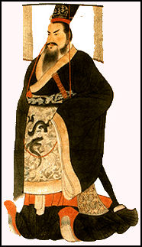
Qin Shi Huang, the First Emperor of China
Notes:
Emperor Qin Shi Huang (chin shee hwong) is often thought of as the greatest leader in Chinese history. He unified China, gave China its name (Qin is pronounced Chin), built large sections of the Great Wall of China and declared himself China's first emperor.
Q: What do you think about Emperor Qin’s clothing? What makes the Emperor look as if he’s important?
A: Class discussion

Slide 3
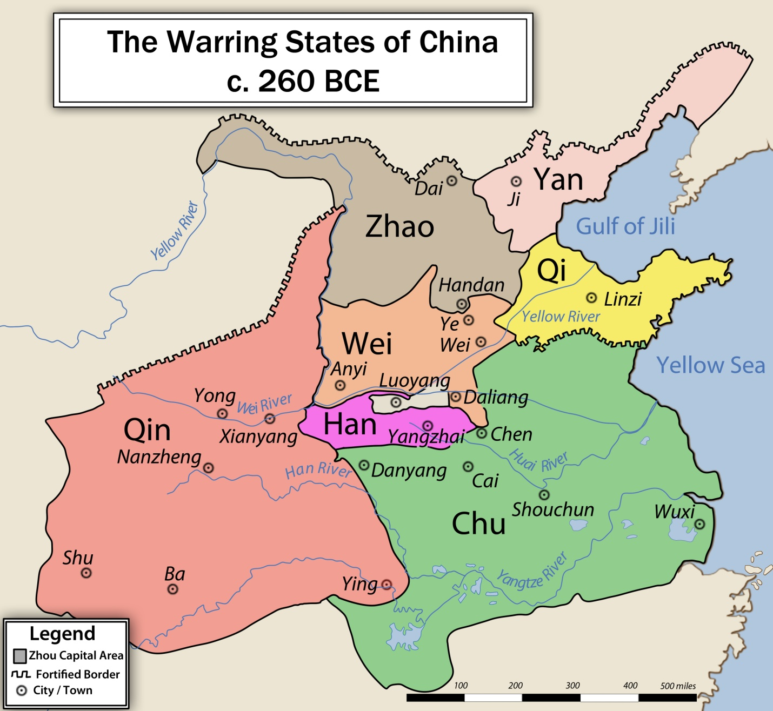
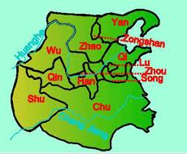
The Warring States
Notes:
Emperor Qin Shi Huang was born Prince Ying Zheng [g (soft g) eng] in 270 BCE. When he was 13, he became king of the state of Qin. During the next 25 years he conquered the other six kingdoms that were part of the Warring States and became feared as a powerful warrior.
Q: What do you think it would it have been like to be king at the age of 13, and to have to fight wars against other states?
A: Class discussion

Slide 4
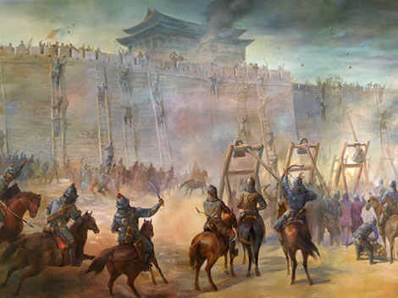
More Than 250 Years of War
Notes:
The Warring States period in China was waged between 475 and 221 BCE. The more than 250 years of fighting gave rise to the "One China" policy established by Prince Ying Zheng to justify making the seven states into one empire.

Slide 5
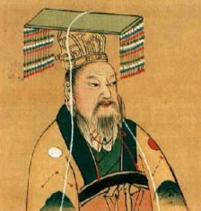
First August and Divine Emperor of Qin
Notes:
After taking control of all seven states, Prince Ying Zheng decided to call himself Qin Shi Huang, which means First August and Divine Emperor of Qin.
He picked “First” because he believed that his dynasty, or rule, would be very long and include generations to come. He used “August and Divine” because he thought he was now equal to a god. He chose “Emperor” to separate himself from his own ancestors—who were only kings and dukes—because he wanted people to think of him as being like the great past emperors of China, who were partly based on historical figures and partly on legends.
Q: What do you think of the Emperor and the new name he gave himself? Compare this to how the elected president of a country is seen.
A: The Emperor gained power by using his name to show he was above other humans, as with the ancient Chinese gods. The elected president of a country is seen as representing his or her people, and leading them fairly under the law for the benefit of all.

Slide 6
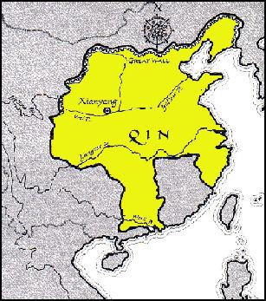
Qin = China
Notes:
The Emperor chose the name of his own state “Qin,” which eventually gave rise to the name we use today, “China.” Now the seven states were combined into one country under one ruler, Emperor Qin.
Emperor Qin made Xingyang (shing yong) the capital of his kingdom, near present-day Xian (she an). He was a ruler who changed the face of China. He could be very cruel, but he also had ideas that we use today.

Slide 7
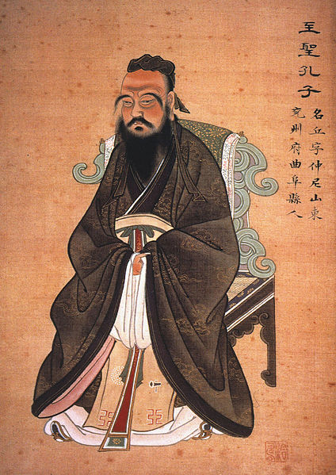
Confucius
Notes:
The Emperor’s government was based on the belief that people by their nature were wicked and needed to be controlled. That is why Emperor Qin had harsh laws governing all aspects of how the Chinese people could live. This system of government policy was called Legalism.
This was very different from the teachings of Confucius (551 or 552 – 479 BCE), which was an important philosophy in China at the time of Emperor Qin. Confucius believed that people would follow good examples of behavior and morality, and live according to the rules of right and wrong. Confucius also emphasized compassion, which meant “What you wish for yourself, do not do to others.” This is a form of the Golden Rule, which is found in a number of religions going back thousands of years.
Q: What is different about these two ways of thinking? What do you think Emperor Qin thought about Confucianism fitting in his vision for a new China?
A: The two ideas are opposite ways of thinking about people and their behavior. Because he set himself up as a god, Emperor Qin believed he could tell the people what to do in all areas of their lives. People were basically bad and needed to be watched at all times. For believers in Confucianism, people shown and taught good moral behavior would choose to live according to the rules of right and wrong.

Slide 8
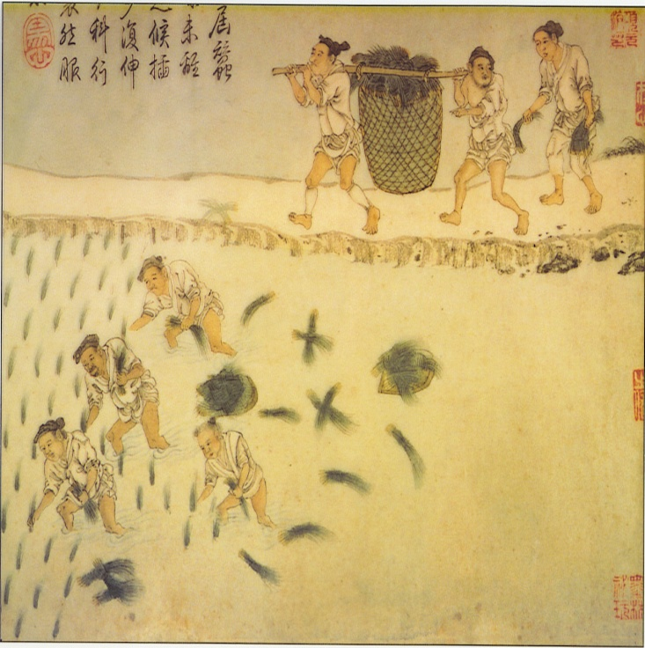
End of Feudalism
Notes:
Emperor Qin replaced the lords and their feudal system, which had given the lords complete control over their own lands and peasants. Instead, he appointed governors from the capital city of Xian. These governors each controlled a large geographic area. This system existed for more than 2,000 years in China.
Q: What advantages come from a single government rather than a number of smaller, independent governments?
A: A single government streamlines laws and society’s functioning, and builds a common cultural identity.
The Emperor abolished serfdom. The peasants were considered serfs, who under the feudal system were treated as slaves. Now they could till the land, and after giving the Emperor his share, keep some crops for themselves. They could even give themselves a last name, which was never possible when the lords ruled. But there was another side to the Emperor’s freeing of peasants from serfdom. Through his government the Emperor now could have peasants to work on his projects, such as the Great Wall of China.
Q: Do you think Emperor Qin believed in human rights, which is a belief that people should be treated with dignity?
A: Having a last name meant peasants could have their own identify. But the Emperor completely controlled their lives, and many died working on his projects because of the harsh conditions.

Slide 9
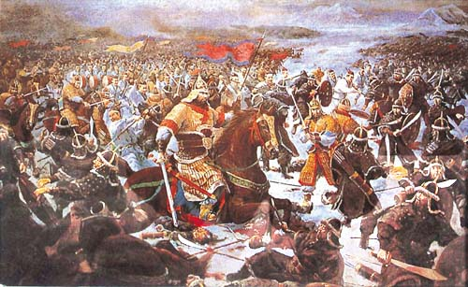
China’s First Professional Army
Notes:
Emperor Qin created China’s first professional army. He replaced the untrained and unreliable peasants under the feudal lords’ control with career soldiers, and the feudal lords, who had acted as military leaders, with experienced generals. From the life-sized clay or terracotta army the Emperor created to be buried with him when he died, we know that he had different kinds of soldiers, including archers (used bow and arrows), infantrymen (fought on the ground), cavalry (rode horses) and charioteers (drove chariots). His army used the most advanced weapons of the time, such as stronger iron swords. One important invention was the stirrup for saddles, which gave the men in the cavalry better balance and offered more control of the horse.

Slide 10
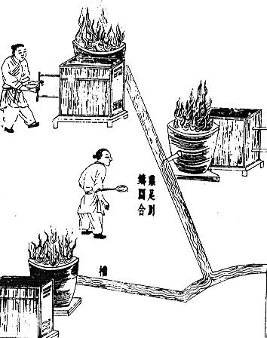
Mass Production of Weapons
Notes:
The Chinese were also able to mass produce many weapons with blast furnaces, which meant that weapons could be made in large numbers and have considerable strength. This gave China a mighty military to be feared.

Slide 11
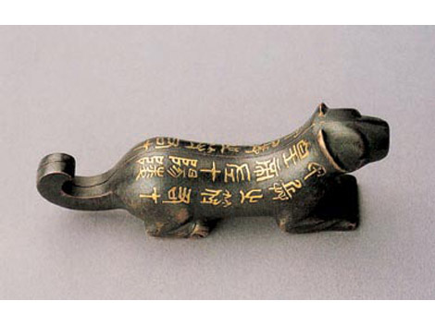
A Tally
Notes:
Emperor Qin was very strict with the military and had rules for everything. For example, if a general wanted more soldiers or weapons, he had to use a tally. This tally was a metal object in the shape of a tiger split down the center with identical gold letters on both sides of the tiger. The general held the left half, the Emperor the right. When the Emperor sent the general the right half, the general could carry out military actions.
Q: What are some of the ways today we have security procedures in our lives?
A: We have electronic security systems in our offices and homes, PINs for all our electronic accounts, and passports and drivers’ licenses with special computerized images to prove our identities.

Slide 12
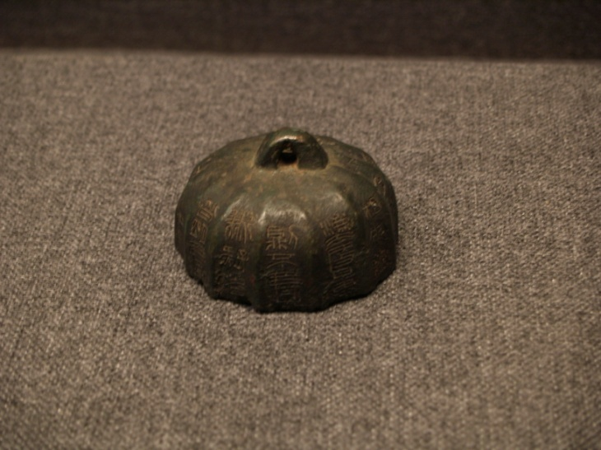
Standardized Measurements
Notes:
Emperor Qin ruled a unified China for only 15 years, but he made changes that are important even today.
Standards and Mass Production
He made laws for all the people to follow. He adjusted weights, currency and measurements so they were the same standard throughout China.
Q: Why are standardized practices important for a country to function?
A: There is much less confusion if a consistent way to measure things and pay for goods and services is used.

Slide 13
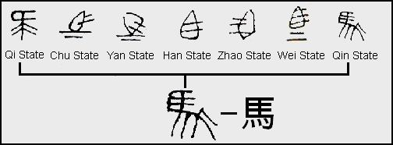
Common Language
Notes:
Common Language
In the 3rd century BCE, during the Qin dynasty or rule, people in China spoke eight languages and many dialects or variations of those languages. Emperor Qin created a way of writing Chinese characters (similar to an alphabet) so that the language could be understood all over China. This common writing system was one of the most important ways that China could be united.
Q: Why is a common language important?
A: The same language means that everyone can communicate, which is important for a society to function well and for a government to structure laws. Having so many different languages prevents the building of a common identify that strengthens a country and unites its people.

Slide 14
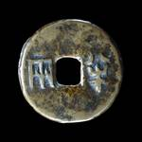
Single Currency
Notes:
Money
Each of the seven states had their own currency, or money. Emperor Qin ordered that a single currency would replace the others. A round coin with a square hole called a banliang (pan liang) was designed as the new form of money. The coin’s square middle represented the earth and its round shape the heavens in early China’s cosmology.

Slide 15
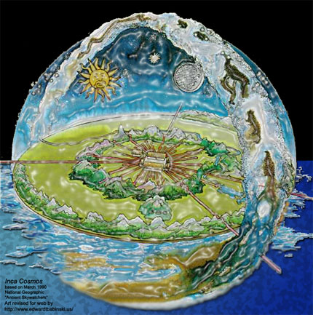
The Banliang and Chinese Cosmology
Notes:
Cosmology is the study and understanding of the universe, which in early history can have many different views depending on the culture.
Q: What does our universe really look like? How do we know?
A. The universe includes all existing matter and space and though we aren’t certain what it looks like, we do believe that it is at least 10 billion light years in diameter. We do know what our galaxy, the Milky Way, and our solar system look like. Our solar system has a sun in the center and is orbited by eight planets: Mercury, Venus, Earth, Mars, Jupiter, Saturn, Uranus and Neptune. We know all of this because of hundreds of years of scientific study.
The banliang was used in China for more than 2,000 years.
Q: How would China benefit from a single currency?
A: People could travel throughout China, businesses could sell goods in a larger geographical area, people could buy goods and services, the military and other government workers could be paid and the economy of China could function and be prosperous.

Slide 16
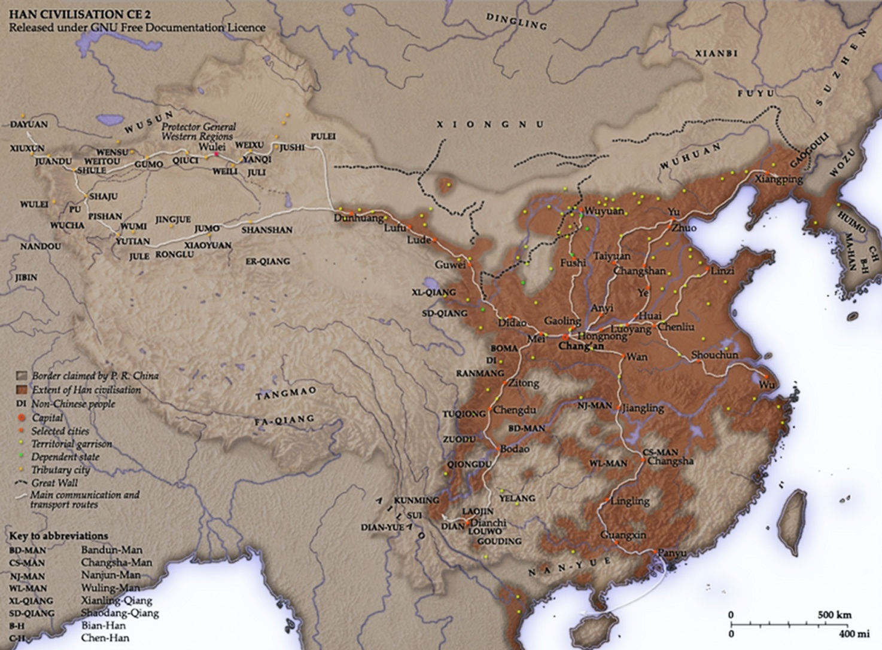
Early Chinese Highways
Notes:
Emperor Qin and Public Works
Emperor Qin had a great vision for China. He changed the way people lived in Chinese society.
Roads
Emperor Qin had 3,700 miles or 6,000 kilometers of road built. One highway had a center lane for the Emperor and his family’s use. The network of roads went out in all directions from the capital city of Xian.

Slide 17
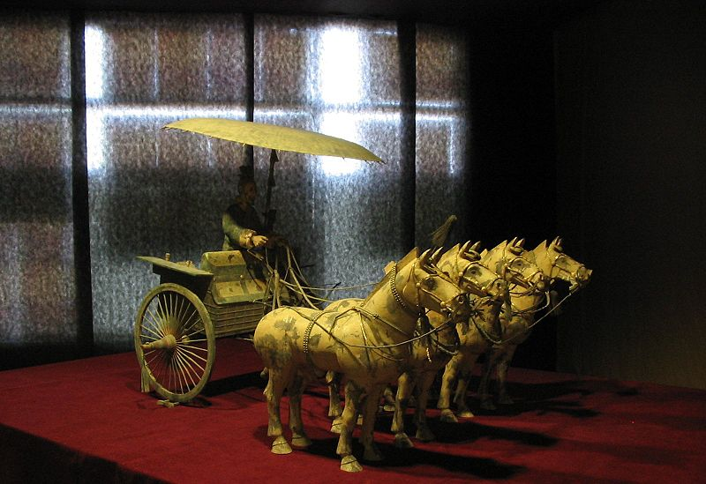
Standardized Axles
Notes:
He even determined the length for carriage axles so the wheels of carts would fit into the ruts of the roads to make travel easier and more efficient.

Slide 18
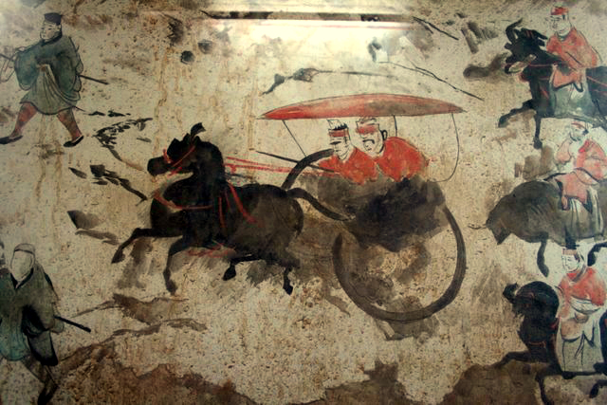
Same Size Axles = Faster Travel
Notes:
Q: Why do you think Emperor Qin built so many roads?
A: The network of roads meant that business or commerce could be conducted throughout China. People would be able to travel to different places more easily. China would have a stronger economy and be politically stronger by being able to patrol its territories better.
Q: What do you think of Emperor Qin’s idea of fixing the length of carriage axles?
A. Today we have standardized roads for vehicles, which work on the same principle as Emperor Qin’s idea for carriage axles.

Slide 19
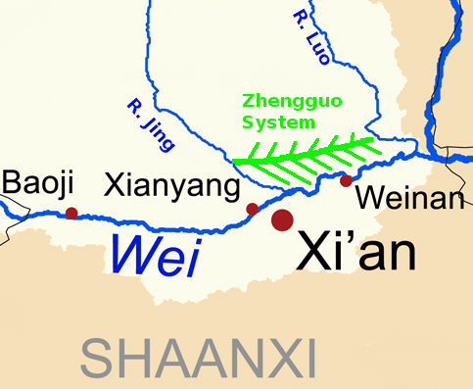
World’s Largest Waterway System
Notes:
Waterways
The Emperor also had a network of canals constructed that became the largest waterway transportation system in the world.
Q: Why do you think the Emperor built so many roads and waterways all over his empire?
A: For the same reason as standardized roads, waterways opened up business opportunities and travel, and kept China easier to protect because there were more ways to patrol the country.

Slide 20
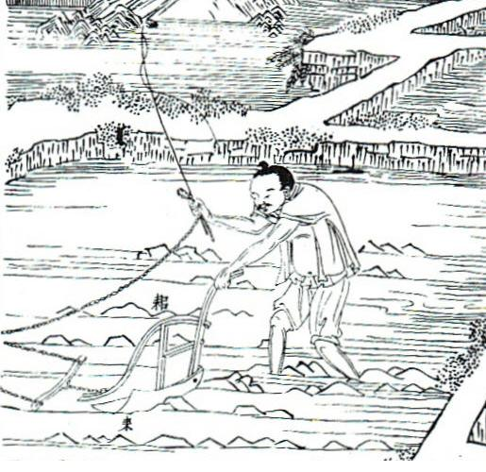
The People and a New China
Notes:
Taxes
To pay for all these projects, Emperor Qin collected taxes in the form of money or goods. Because the state owned all property, the people had to do what the Emperor demanded. For example, the peasants had to give up half of all they grew as taxes to the Emperor.
Q: What do you think about the Emperor collecting taxes? How do you think governments today use taxes?
A: Today, governments use taxes to pay for public works, such as constructing highways, dams, bridges and office buildings, running public schools and colleges, as well paying the salaries of elected officials and people who work in government jobs.

Slide 21
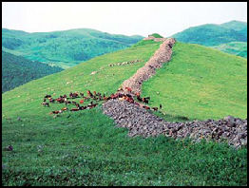
Great Wall of China Begun
Notes:
Emperor Qin and the Great Wall of China
The Great Wall of China was a major project during the Emperor’s reign. We can still see the Great Wall today in China. It is one of China’s leading tourist attractions. Before Emperor Qin came to power, many of the former warring states had built walls from earth and rubble to keep out invaders. Beginning in 221 B.C.E., Emperor Qin ordered that the walls be joined together to create a unified barrier to protect China. The walls extended 1,500 miles or about 2,400 kilometers according to some accounts.

Slide 22
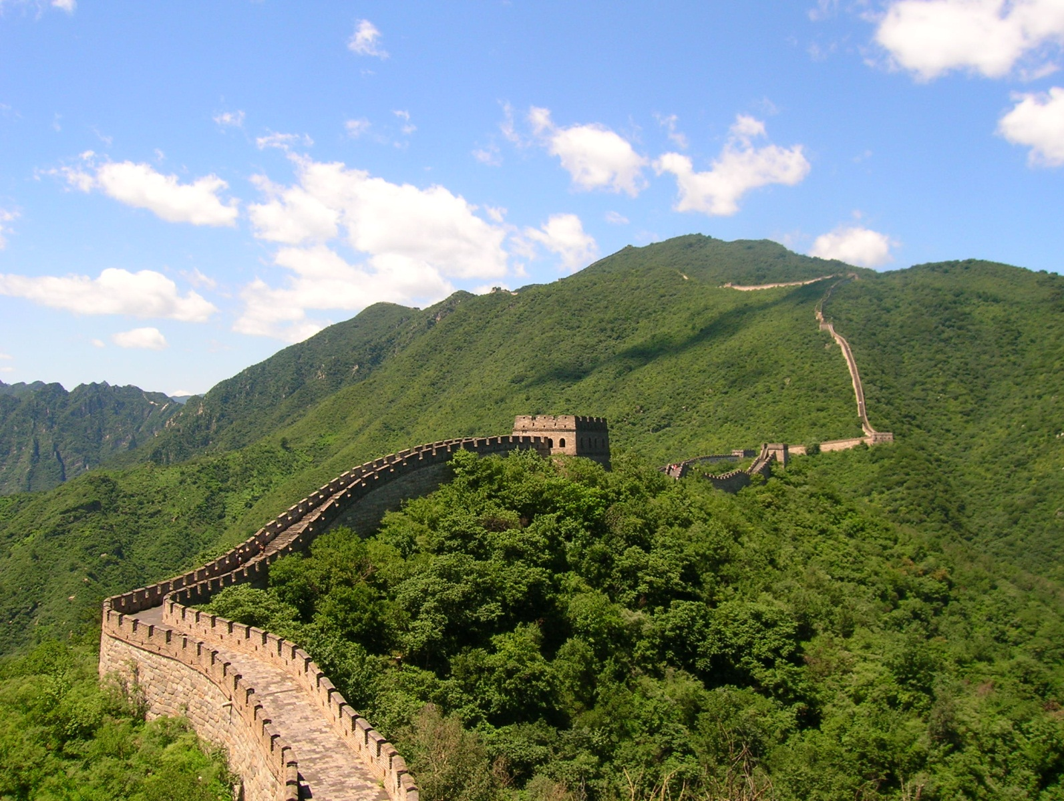
The Great Wall Is Built
Notes:
Building the Great Wall of China took more than 300,000 laborers, including peasants and convicts, working over the next 12 years. Many people whom the Emperor felt opposed his government and ideas also toiled on the wall as political prisoners. The conditions were severe. Forced to work or face death, tens of thousands of workers died. This led people to call the Great Wall "the longest cemetery in the world."
The Great Wall took nearly 2,000 years to complete from the Warring States Period (475 BC - 221 BC) to the Ming Dynasty (1368-1644). It eventually extended for 8,851.39 kilometers or 5,500 miles.
Q: What do you think about the cost of human life in building the wall? Why didn’t Emperor Qin treat his workers better?
A: Class discussion

Slide 23
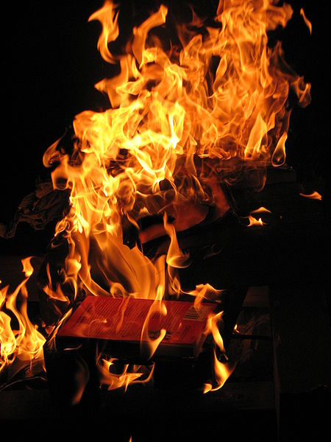
Erasing History
Notes:
Emperor Qin was a cruel ruler who wouldn’t allow anyone to speak or act against him. For example, because the Emperor only allowed books that praised him, all others were burned. At least 460 Confucian scholars were killed because they believed differently than the Emperor. Emperor Qin wanted to wipe out all previous history and start all over with his reign.
Emperor Qin ruled by fear. There were so many laws, people often didn’t know when they broke one. Families were punished along with the lawbreaker. People convicted of crimes faced severe punishments, included amputations and face tattoos.
Emperor Qin believed the color black was a pure color, so he ordered that people wear clothing of that color.
He also spent huge sums to build palaces (some 700) and his massive tomb. China eventually had no money, and the people lived in poverty. All this made the people hate the Emperor.
Q: Why did Emperor Qin act the way he did?
A: The Emperor didn’t have to consider other people because he was appointed for life to rule. He was not voted in, as in a democracy. He essentially could do whatever he wanted.

Slide 24
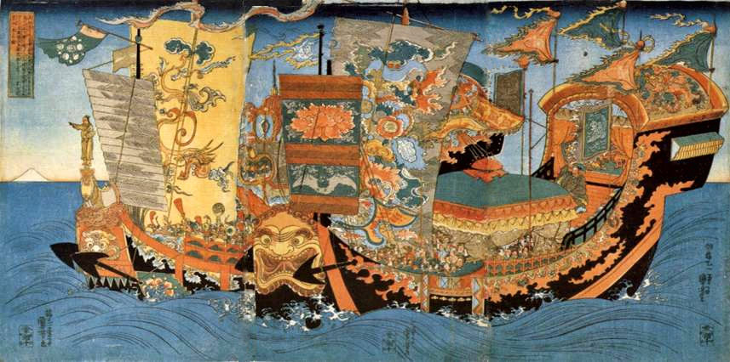
Looking for Eternal Life
Notes:
The Emperor wanted to live forever. He used many herbs, pills and potions, including mercury, which is poisonous, and sent men throughout many lands to find the one ingredient that would give him eternal life.
Q: Can you imagine what it would be like to live forever? How would life be different with family and friends if only you lived forever? What would the planet be like if everyone lived forever?
A: Class discussion
Q: What do you think about this article describing how people in the future could live to be 300 years and more with the use of technology? http://www.govtech.com/technology/300-Year-Old-Humans-Internet-of-Everything.html
A: Class discussion

Slide 25
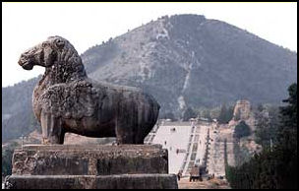
Emperor Qin and the Afterlife
Notes:
Emperor Qin had his achievements carved into the side of mountains so no one would forget him. He couldn’t accept that his greatness wouldn’t last forever. He even began building his tomb, or where he would be buried, soon after he became King of the state of Qin. His tomb would contain all the things he would need in the afterlife. Over the course of more than 30 years around 700,000 workers built him the palace that would be his tomb. He tried to recreate his entire empire and court underground in clay, bronze and wood, including his army, officials, animals, utensils…even acrobats and dancers to keep him entertained in the afterlife. (For a picture of tomb layout, go to http://dsc.discovery.com/convergence/firstemperor/explore/explore.html)
Q: What do you think about Emperor Qin’s ideas for immortality, or living forever?
A: Class discussion

Slide 26
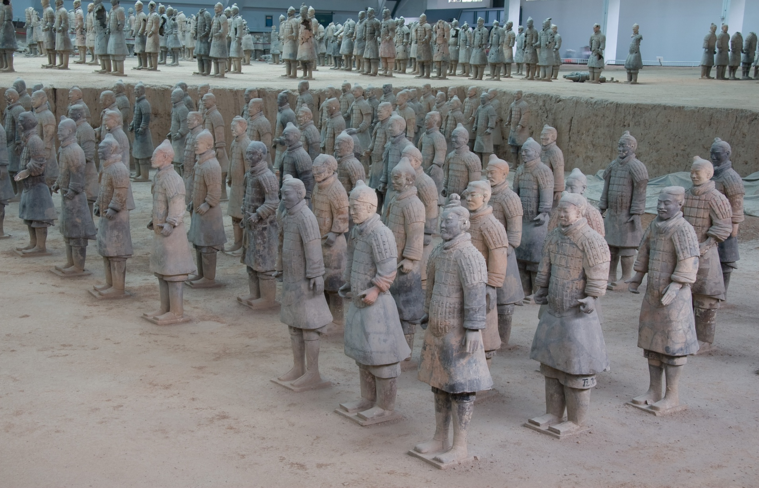
The Terracotta Army
Notes:
To guard this massive tomb, 10,000 soldiers modeled on the Emperor’s armies were made out of terracotta, a type of clay fired to become very hard. The tomb and the pits containing the Terracotta Army or Warriors are recognized as the world’s largest tomb by the Guinness Book of World Records.

Slide 27
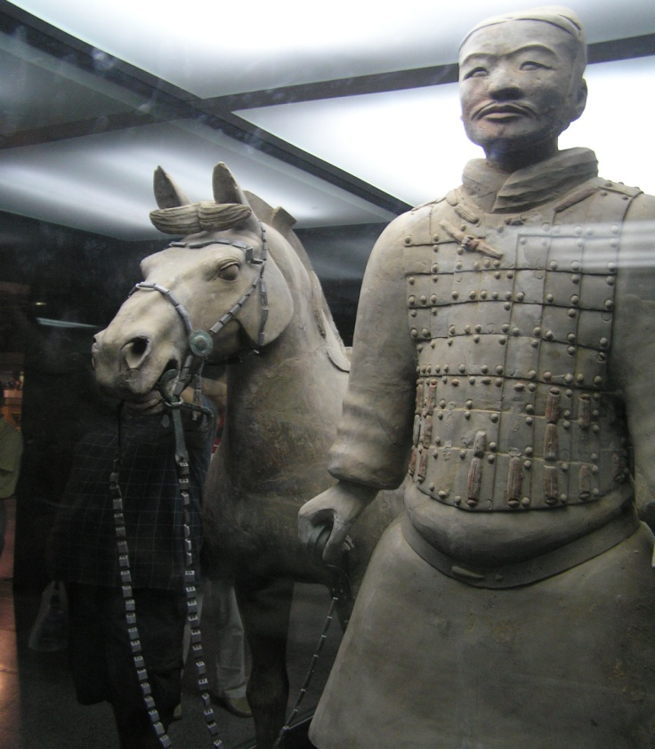
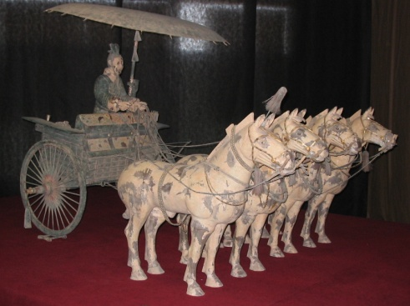
Thousands of Figures in Stone
Notes:
The Terracotta Army of Emperor Qin has more than 10,000 life-sized figures found in three huge pits. Most of the figures are armed warriors who were designed to protect Emperor Qin from his enemies in the afterlife. Their formation is the way they would be in battle. The archers are lined up first. Behind them are the cavalry on beautiful, large horses, the infantry with their weapons ready and the charioteers in their chariots pulled by horses.
The Terracotta Warriors are often called the Eighth Wonder of the World.

Slide 28
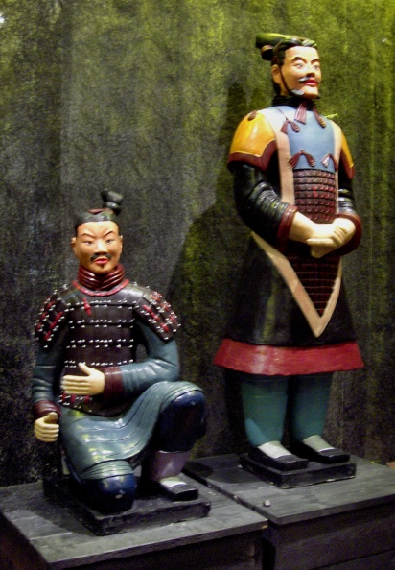
Ancient Faces
Notes:
The terracotta soldiers are remarkably lifelike. Each has an individual face with its own hairstyle. Some warriors look calm, others look ready for battle. Interestingly, their faces come from eight different models, most likely representing the different looks of the people of the time. The clothing and armor are different for each soldier.
Once the terracotta form was made, the figures were painted in bright colors, including their faces. Today, only a few figures have color remaining because the paint has faded over the centuries.
In 1974, a local farmer was digging a well and discovered some of the terracotta soldiers. Archeologists were surprised because although Emperor Qin’s tomb was known to exist from writings at the time, there was no mention of the Terracotta Army.
The Terracotta Warriors are a popular tourist attraction in China, and many figures have become part of traveling exhibits around the world.

Slide 29
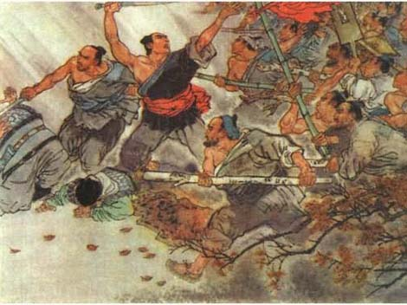
The End of the Qin Dynasty
Notes:
In the last years of his life the Emperor was so afraid that one of his people would kill him that he slept in a different place each night. He also was becoming increasingly affected by mercury poisoning, which he had hoped would allow him to live forever but instead made him mentally unstable.
Emperor Qin died suddenly in 210 BCE at the age of 49. The man who had thought of himself as a god was gone. He had also believed that the Qin Dynasty would last thousands of years. In 206 BCE, the Qin dynasty ended when the people fought against the unpopular government—using some of the weapons they dug up from the Terracotta Warriors—and new leaders took over.
Q: Emperor Qin thought his empire would live for thousands of years. What do you think about the fact that it only lasted a few years? Why do you think he tried so hard to live forever?
A: Class discussion

Slide 30
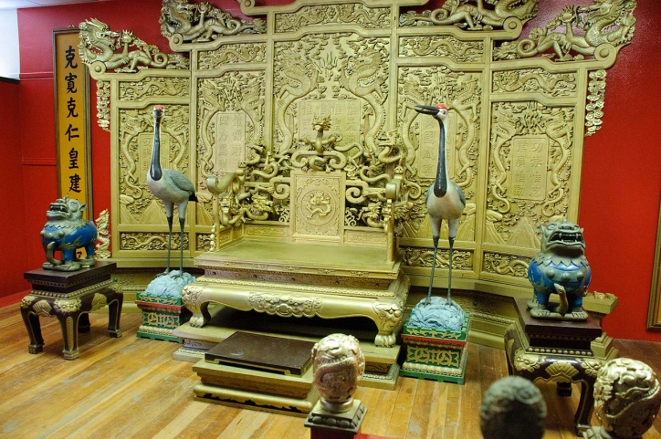
Hidden Treasures?
Notes:
Emperor Qin’s tomb has never been opened because present day Chinese officials say there is not enough money to do the excavation, or digging, properly. Archeologists, who study ancient people and their cultures, consider the tomb a great mystery and can only guess at all the treasures inside. This picture is a recreation of what the tomb may contain. According to records that describe the tomb, not only are priceless jewels and gold in the tomb, but it is booby-trapped with crossbows, weapons that shoot arrows. It was also rumoured that the architects and designers of the tomb were buried inside so no one would know how to find the treasures. Some archeologists believe the site may have been looted, but others do not agree. Looting, or stealing, is often a major problem with ancient places. The Emperor’s tomb is one of UNESCO’s World Heritage sites. UNESCO stands for United Nations Educational, Scientific and Cultural Organization. To learn more, and to see an interactive map of sites around the world, go to http://whc.unesco.org/en/about/.
Q: Why is looting against the law?
A: Since looting is stealing, it is against the law. But it also can destroy ancient places by taking items from where they are buried. A lot of information about objects and how people used them is lost when that object is taken from its original site.

Slide 31
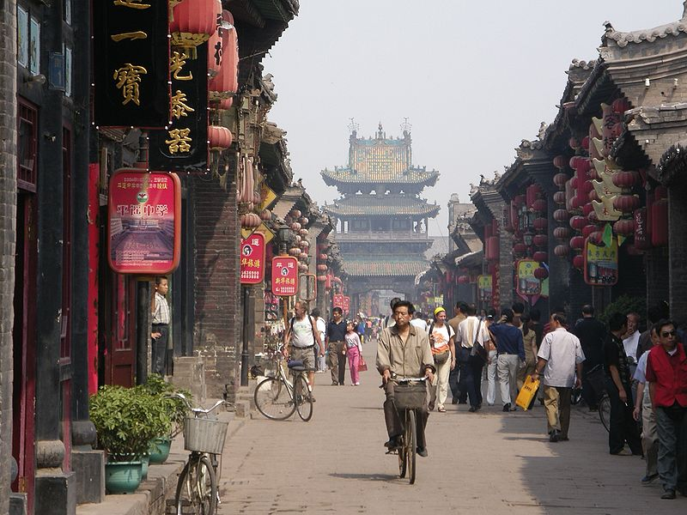
China Today
Notes:
The Legacy of Emperor Qin
Although his reign lasted only 15 years, Emperor Qin’s influence still lasts today.
China is a unified country because of the Emperor, who also gave the country a name. Today China has the largest population in the world with more than 1.3 billion people, or 19 percent of the world’s population.

Slide 32
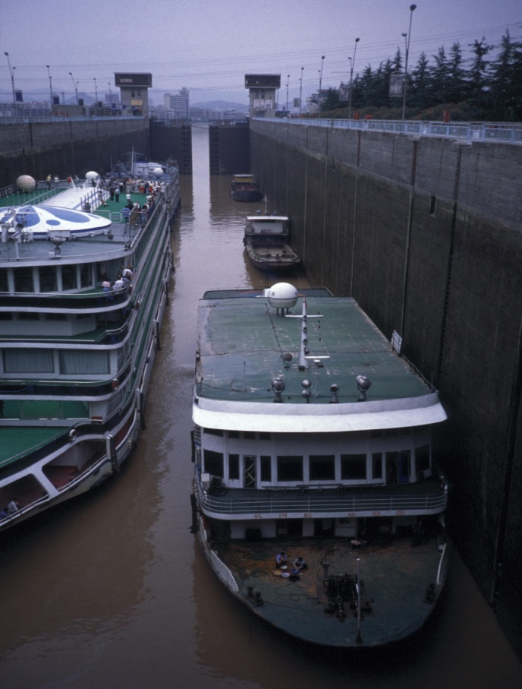
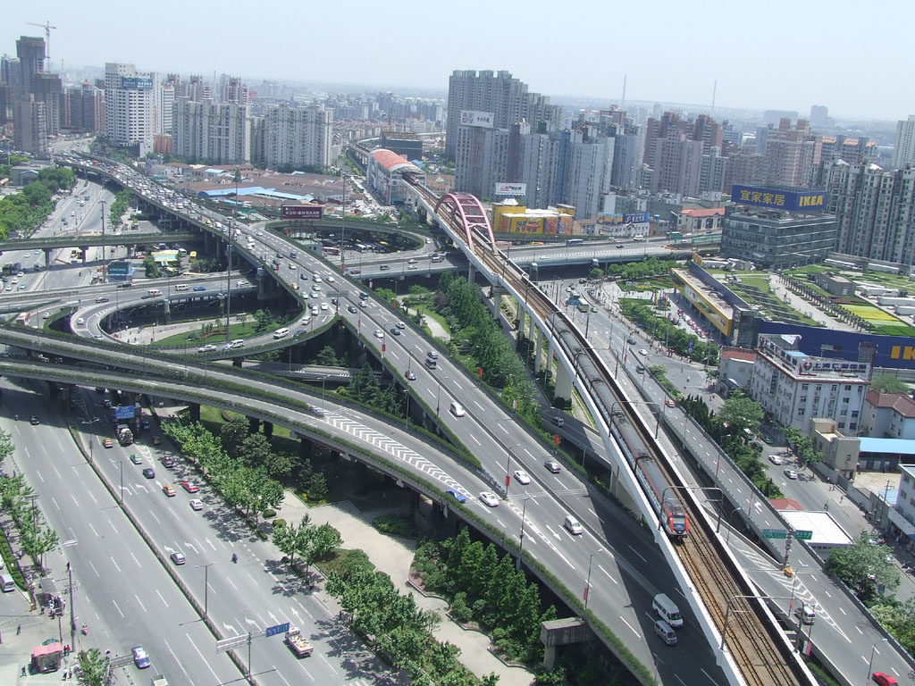
Modern Transportation
Notes:
The Emperor’s ideas for large highway and water transportation systems are seen today in countries around the world.

Slide 33
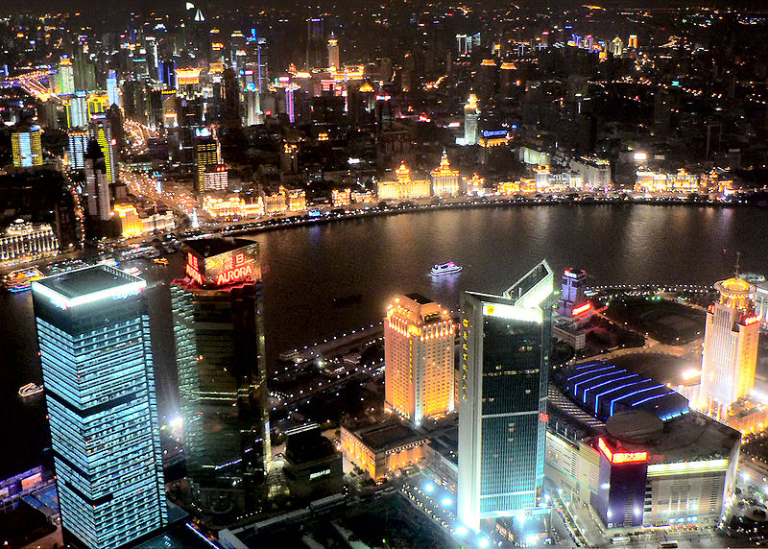
Shanghai, China’s Most Populous City
Notes:
Emperor Qin took China from a feudalistic society to one that the government managed through officials, laws and policies. That model has been followed for 2,000 years by China’s government.
He ordered that everyone speak the same language to make sure the people of a unified China could communicate with each other.
He had China develop its own currency, which made buying and selling in and outside the country possible. China today has a massive economy due in part to Emperor’s Qin’s vision for future growth and his ideas for creating a powerful nation.
The Qin Dynasty used mass production and new processes to create better metals that were stronger and lasted longer. We use mass production today.
The Great Wall of China, the Emperor’s tomb and the Terracotta Warriors are major tourist attractions. They also give us a picture of people who lived more than two thousand years ago, and the Emperor who contributed so much to ancient and modern China.

Slide 34
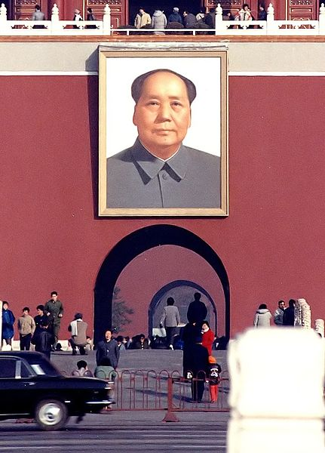
Chairman Mao Zedong
Notes:
One of the most important figures in the twentieth century, not only in China but in the world, was Mao Zedong (1893-1976). He was a great admirer of Emperor Qin, and also believed that he was beginning a new China and erasing the old. Chairman Mao, as he was called, was a communist, which is a policy where there are no rich or poor people, no one owns property and everyone has an equal share of goods and services as determined by the government. Like Emperor Qin, Chairman Mao had strict control of his people. For example, in 1966 Mao started the Cultural Revolution to eliminate people and ideas that were not acceptable to him. In the process 1.5 million people were killed and many ancient and historical sites were destroyed.

Slide 35

China and Government Control
Notes:
China continues to be ruled by the Communist Party begun by Mao Zedong. Over the years it has become an important part of the world community. But life in China can be difficult if you do not do what the government says. People who speak out against the government, called political dissidents, can be imprisoned. The Internet as well as satellites are often blocked from use. With today’s technology, many governments are able to hack, or break into, computers. People who believe in privacy and free expression argue that this kind of hacking, no matter the country involved, needs careful watching to protect human rights.
Q: Why does the Chinese government not allow people to any information they want through the Internet or satellite programs?
A: Knowledge is power. History has shown us that when people see that the world is not as their government tells them, they can question the government’s authority, which can lead to political unrest.
Q: Why is hacking against the law?
A: When you hack into someone’s computer for information, it is the same as breaking into his or her house to steal property. Some people think hacking is like a game or a challenge. But there are serious consequences if you are convicted of hacking, including fines and even going to jail.

Slide 36
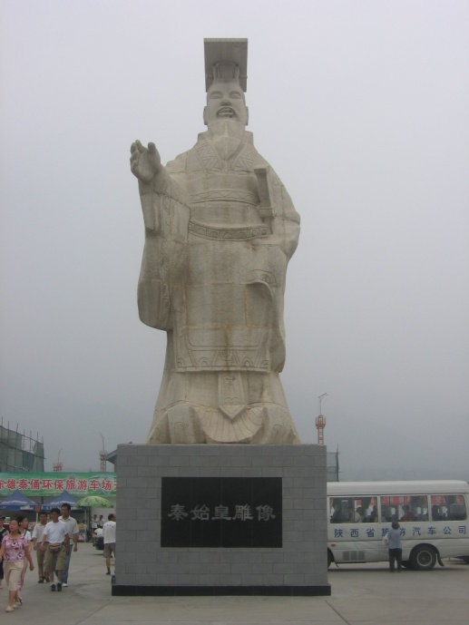
Emperor Qin Shi Huang Remembered
Notes:
Emperor Qin was a ruler who was complicated. He saw how to create a China that would be a powerful country, which we see today. But he wanted to be treated as a god and thought he should live forever. Because of this, his people suffered as they built all his great works. We can learn a lot from Emperor Qin’s rule about how a government should work and how a ruler should live.

